Slide 1
Combining Observations and Modeling to Improve Wind Resource Assessment
Big Data, AI & Blockchain
12 September 2019
Boston, Massachusetts
Joseph Brodie, Ph.D.
Director of Atmospheric Research

Slide 2

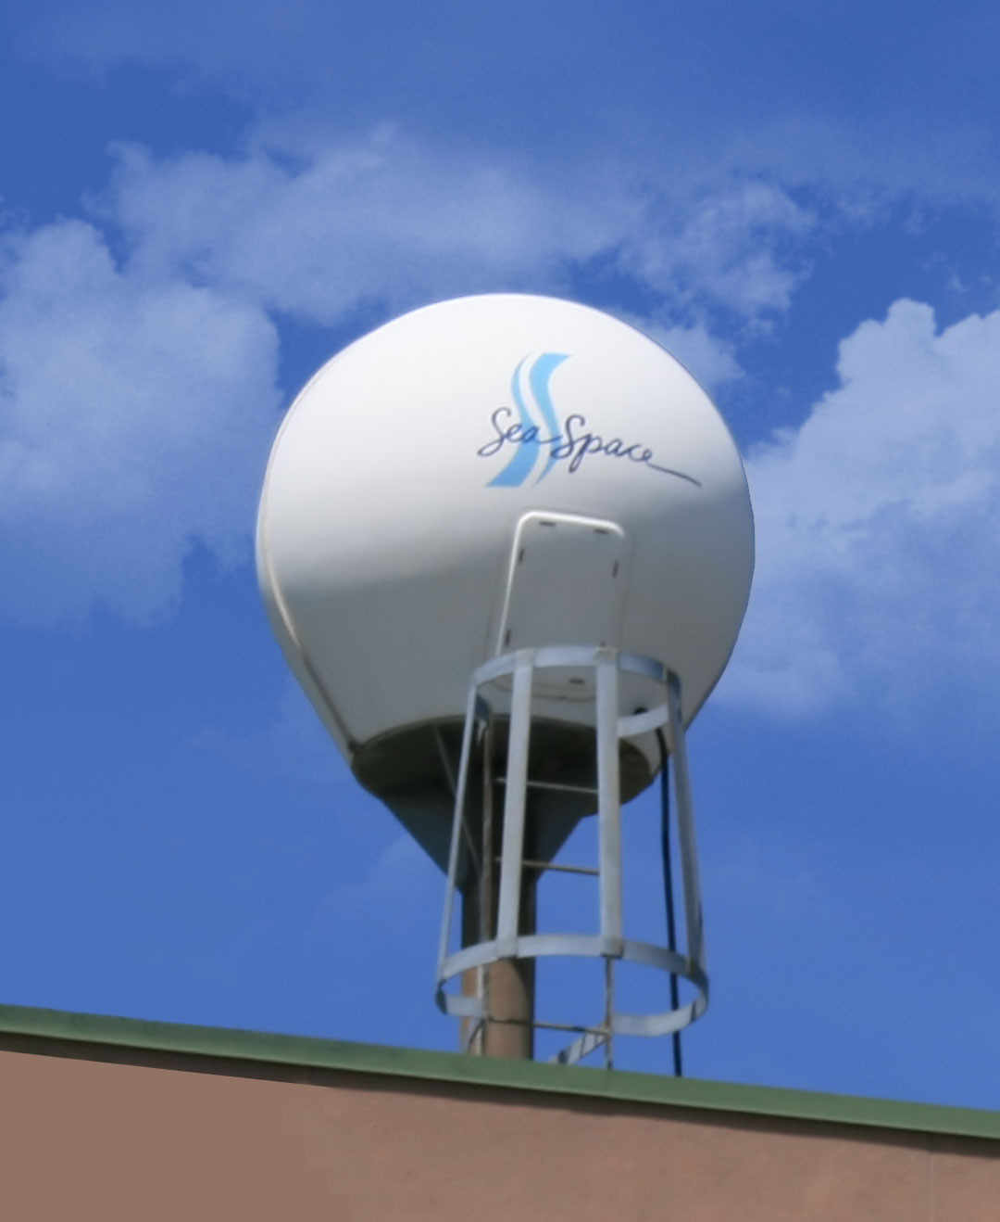
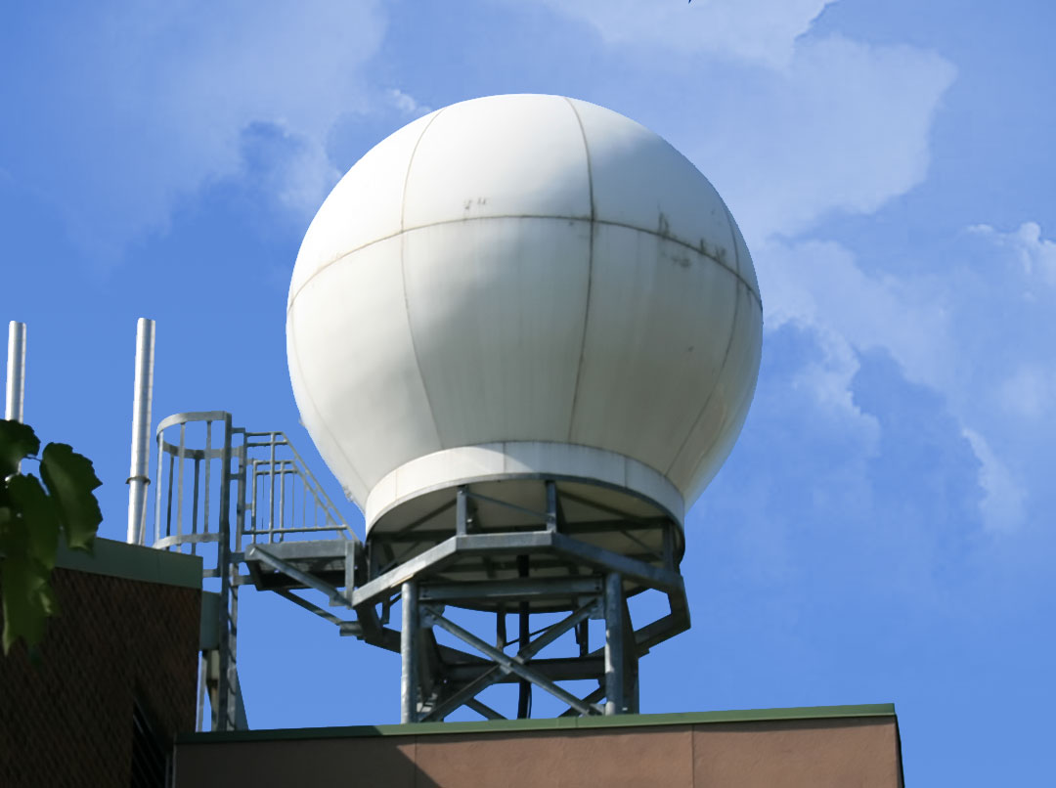
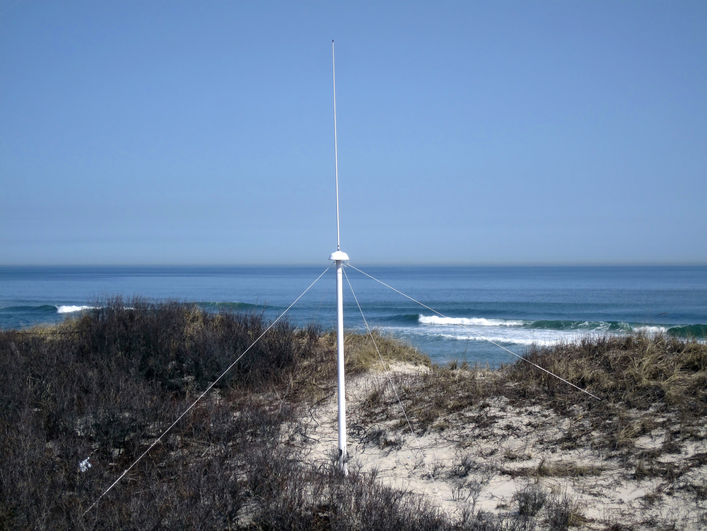
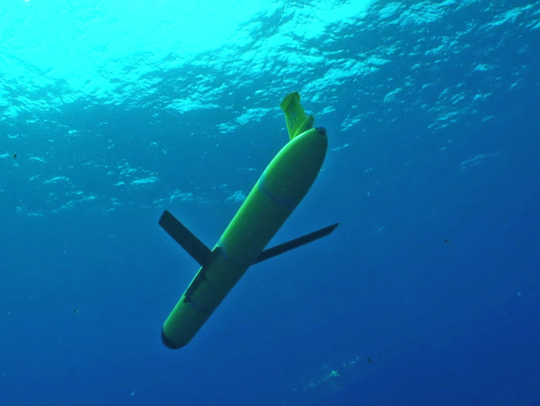
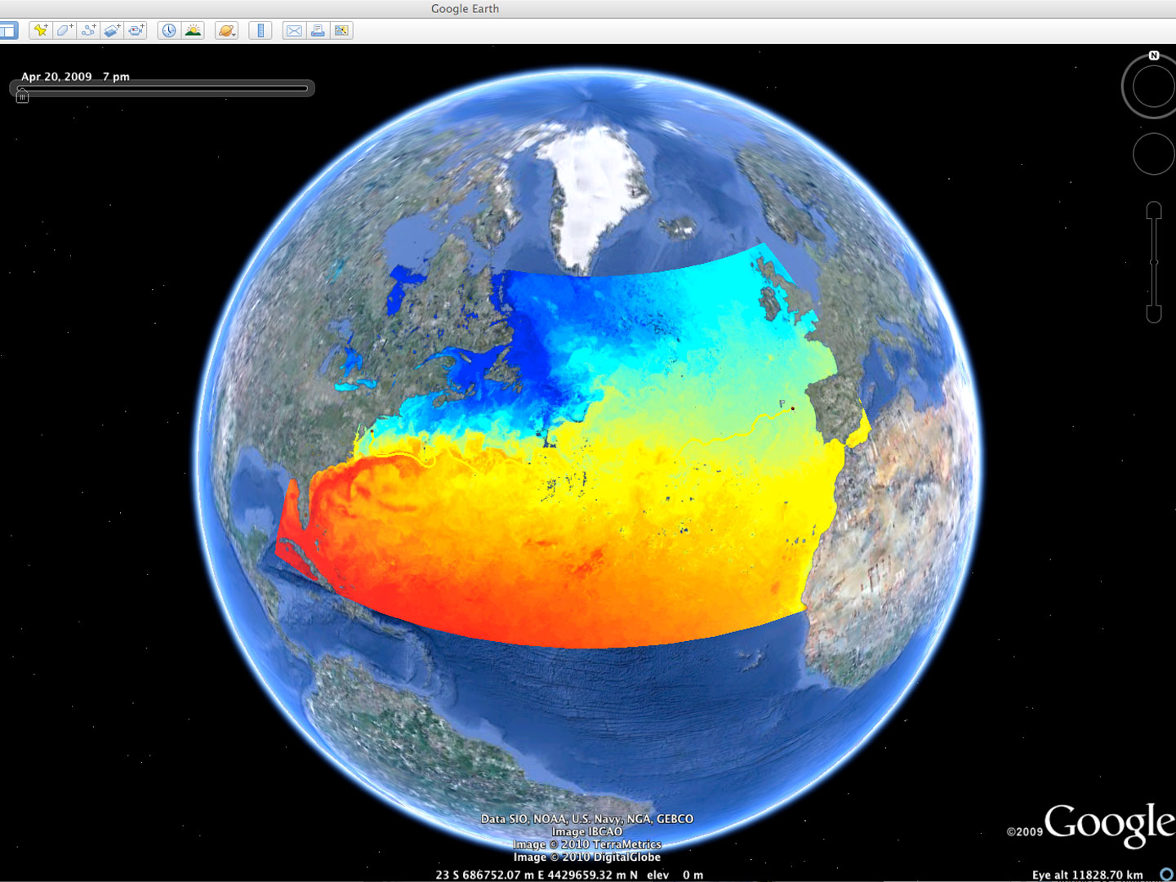














Rutgers University - Center for Ocean Observing Leadership
MARACOOS – A forum to bring forward the best science & technology
L-Band & X-Band Satellite Receivers
46 Site CODAR Network
~ 500 Glider Deployments
3-D Nowcasts
& Forecasts
+ Many More!
Notes:
2
Companies – TWR, Seaspace, CODAR, Aquawind, Weatherflow, Sequoia Scientific, Seabird Electronics, Wetlabs, Satlantic, Nortek

Slide 3
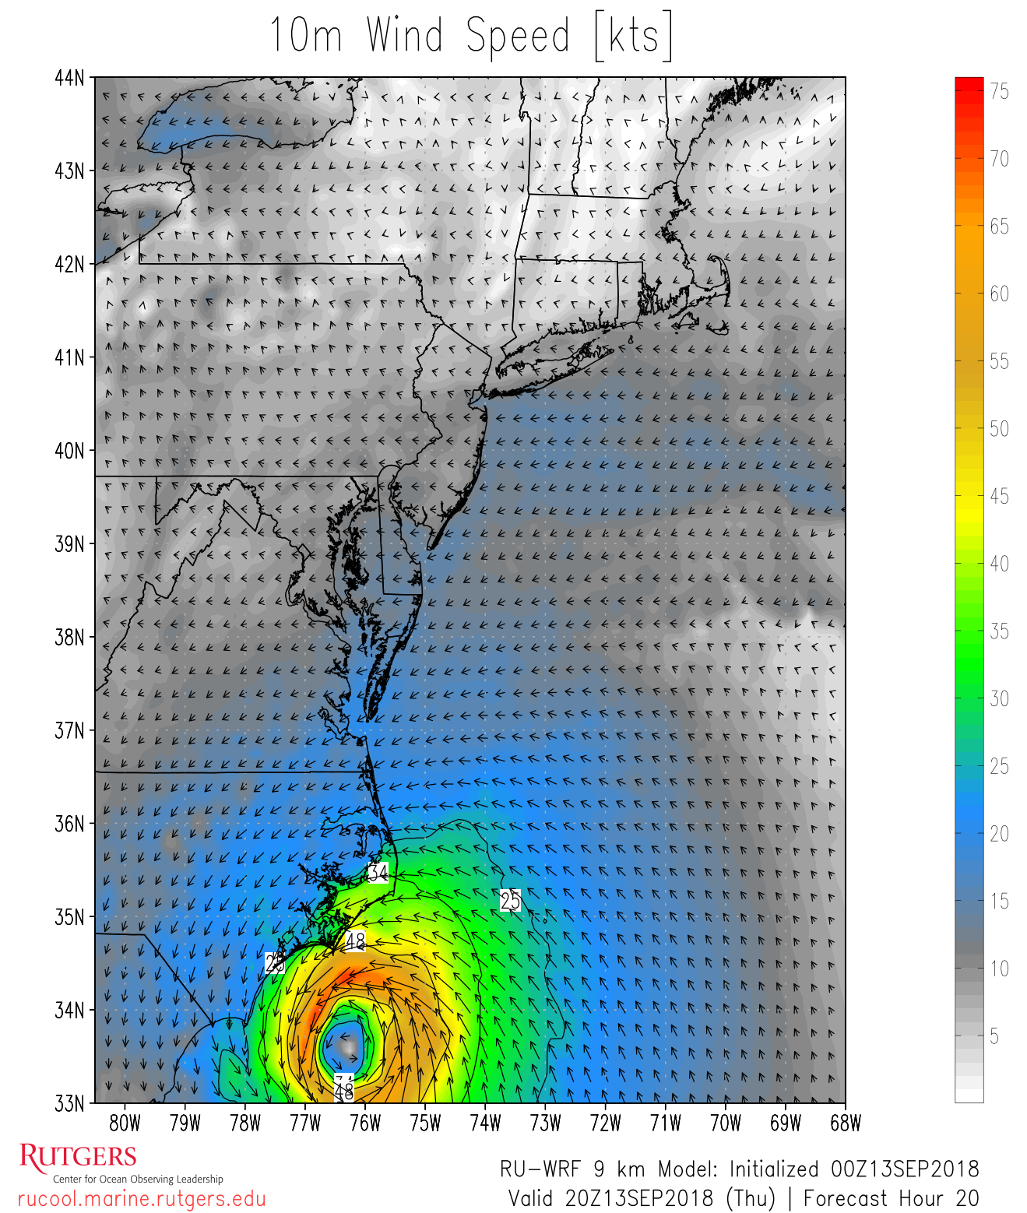

Rutgers University - Center for Ocean Observing Leadership
MARACOOS – A forum to bring forward the best science & technology
Data QA/QC
5 Day Atmospheric Forecast
4 Day Ocean
Forecast
Run Daily
4DVAR Data Assimilation
Run Daily
Notes:
Better observational data leads to better models

Slide 4





16 Units, Including
Climate Institute
Institute of Earth, Ocean, and Atmospheric Sciences
Center for Ocean Observing Leadership
Center for Remote Sensing and Spatial Analysis
Center for Fisheries and Ocean Sustainability
Center for Energy, Economic, and Environmental Policy
Center for Advanced Infrastructure and Transportation
Heldrich Center for Workforce Development
NJ Agricultural Experiment Station
NJ Office of the State Climatologist
Notes:
16 Schools and Centers

Slide 5
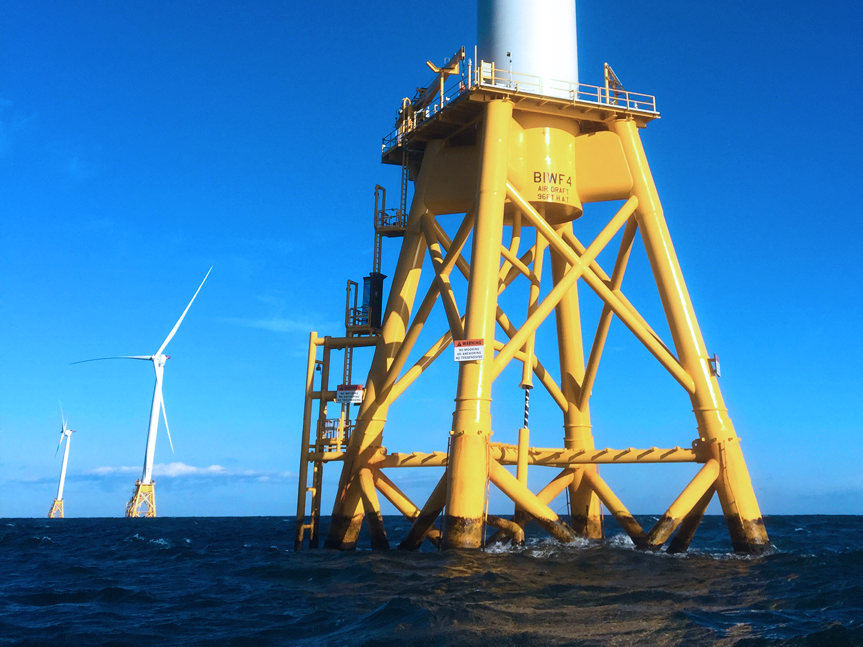
Data for Wind Resource Assessment
Observations
  Historical data (i.e. NOAA met buoys)
  Meteorological towers
  Lidar
Modeling
  Large eddy simulation models
  Specialized wind farm models
  Atmospheric models
Public v. Private?

Slide 6
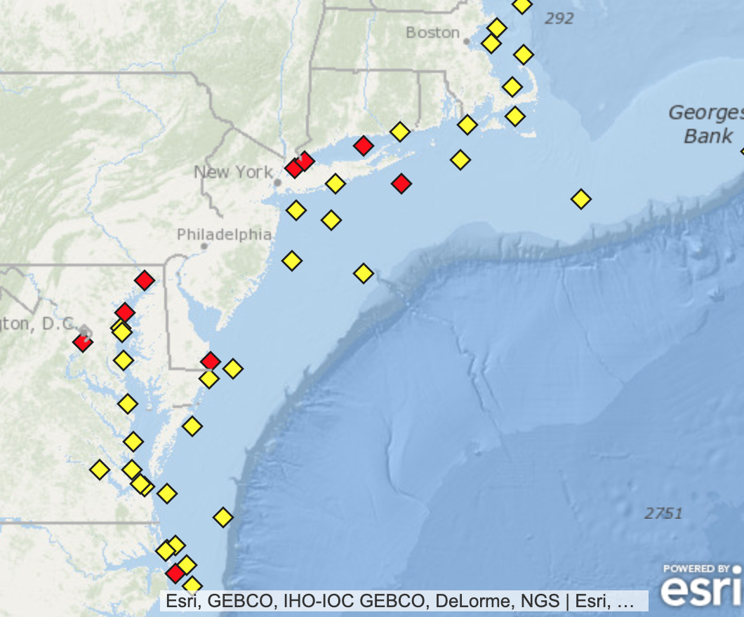
Historical Data
NOAA meteorological surface stations and buoys
NOAA and most university data is public and easy to access
Long time records – some stations have decades
Very limited offshore data
Most stations at 10 m height or less
NOAA NDBC
Notes:
Useful for initial evaluation, correlation with other observations, validation of models
Buoys often in close proximity to shipping lanes and harbors

Slide 7
Meteorological Towers
“Gold standard” for winds
Observations at multiple heights
Ability to measure multiple parameters, including temperature (stability), fluxes, turbulence
Very little public data in US
Expensive!
As offshore turbines continue to get larger, even more expensive to measure at hub heights

Slide 8
Lidar and Flidar (Floating Lidar)
Rapidly becoming the new “gold standard” for wind observations
Much less costly than towers
Measures the complete vertical wind profile, at heights exceeding 200 m
Does not allow in situ measurements of other variables at height (no stability or turbulence)
Often limited deployment time (1-2 years)
Very limited public data (DOE, NYSERDA)
AXYS
Notes:
Even 5 years ago, flidar wasn’t a serious option – rapid advancements in this technology
Combine limited datasets with longer term datasets and modeling
DOE buoys, new NYSERDA buoys

Slide 9
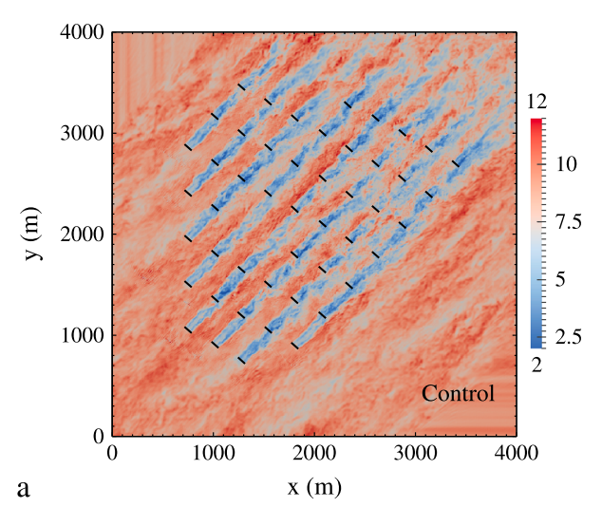
Large Eddy Simulations
Very high resolution fluid dynamics models
Allow for detailed study of dynamics of turbine-turbine interactions (wake effects)
Very computationally expensive
Useful for case studies, and to define parameterizations for other models
Archer et al. 2013

Slide 10
Wind Farm Models
Specialized models to calculate wind farm productivity
Commercially available (i.e. DNV GL WindFarmer, AWS/UL Openwind)
Computationally efficient, thorough evaluation of expected farm performance
Can use a variety of wind inputs
  Observational climatology
  Atmospheric model output data
  Some combination of these
Need good met data for good results!

Slide 11
Atmospheric Models
Solves physical equations to calculate state of the atmosphere – i.e. weather models, numerical weather prediction
Can be done on timescales from minutes to centuries
Resolutions from 100s of meters to kilometers
Scalable to computational limitations and operational needs
Many are freely available, but require expertise to run

Slide 12
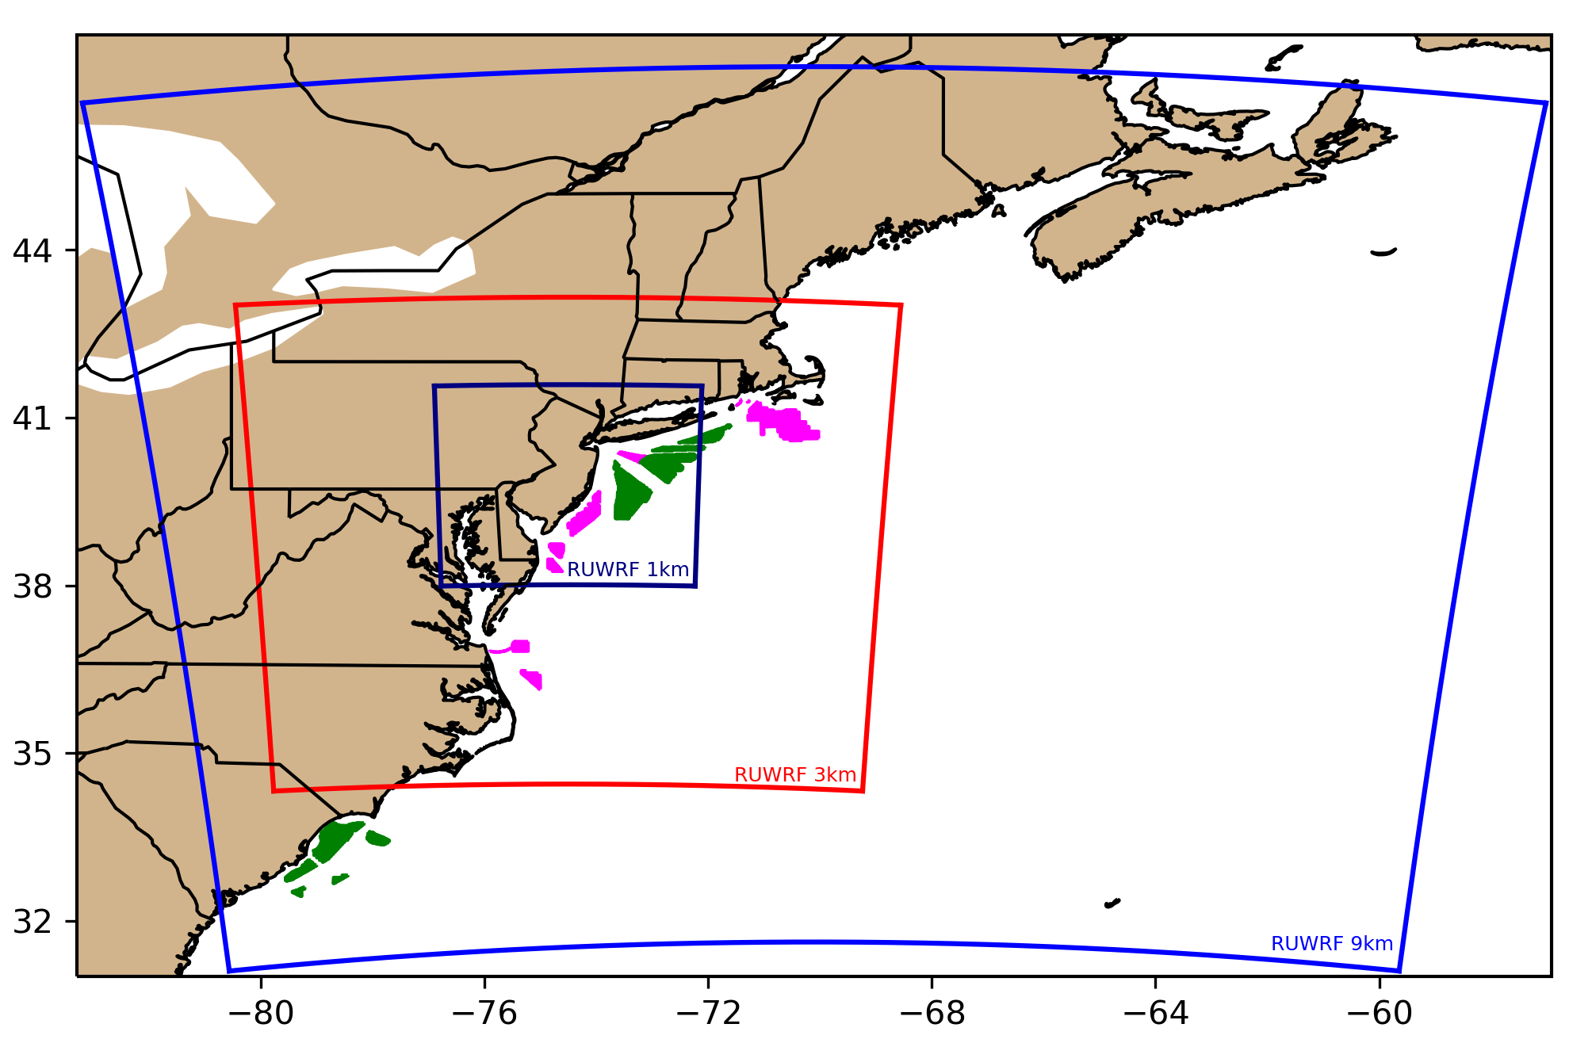

Modeling NJ’s Wind Resource: RU-WRF
Continuously run daily since 2011 through present day
Includes modeling done at 9 km, 3km, and 1 km resolution
Hourly data, to allow for various types of analysis
Utilizes RUCOOL Coldest Dark Pixel sea surface temperature to capture coastal upwelling, a large driver of coastal wind features like sea breezes

Slide 13
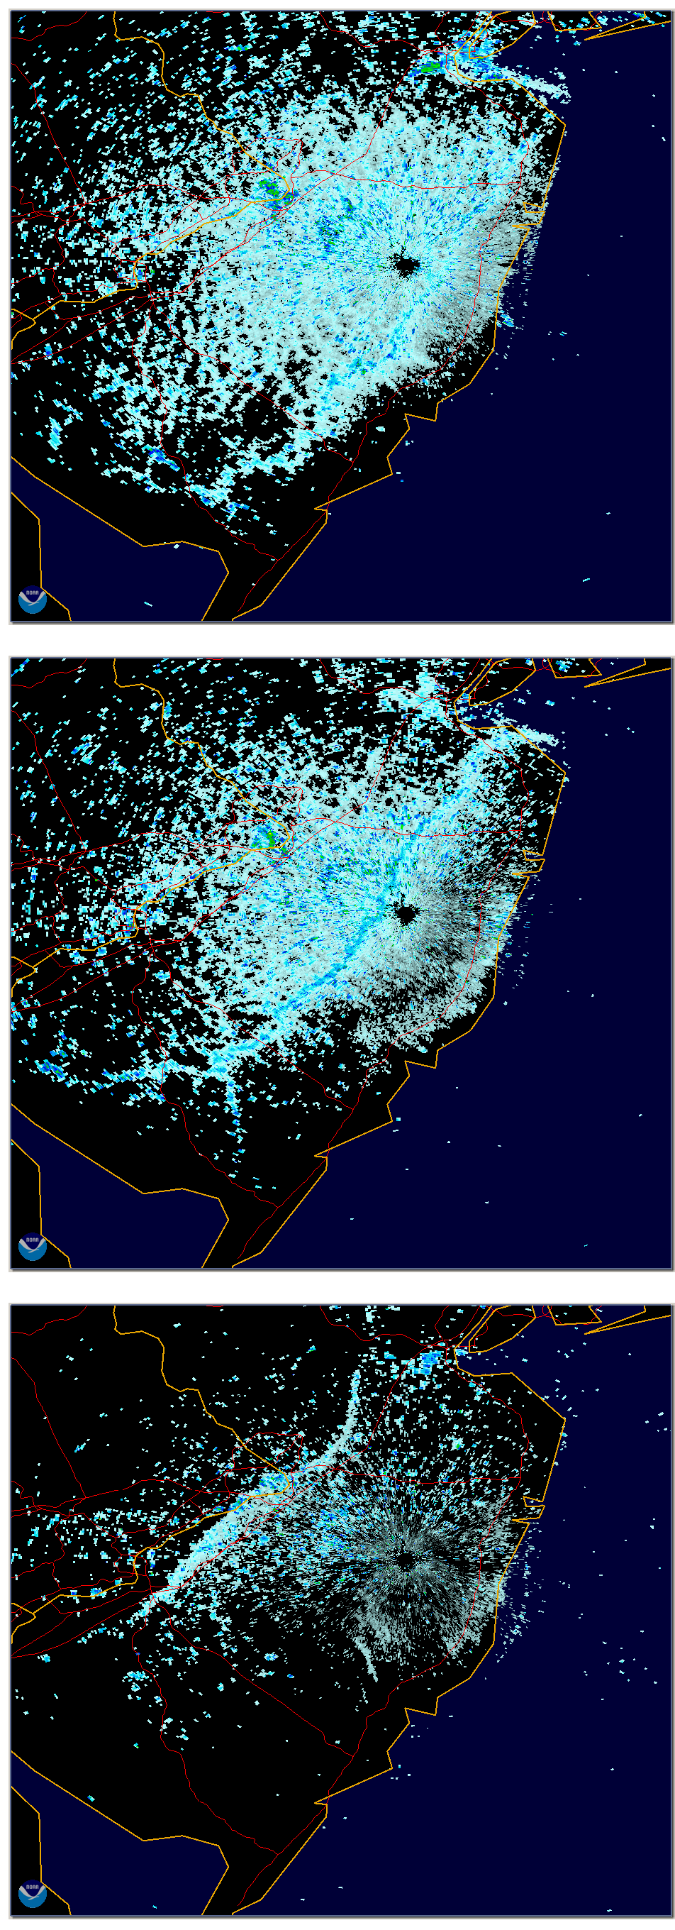
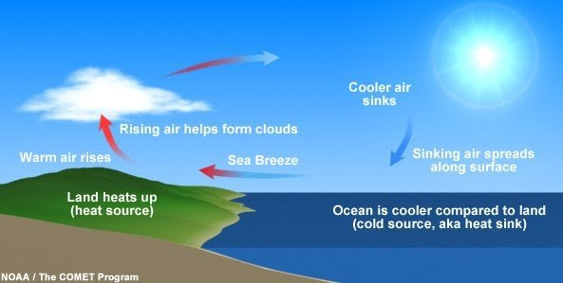
Sea breezes are common;
Driven by land-sea temperature difference
Depending on height and strength of the return flow, and the location of the subsidence zone, turbines could experience different winds throughout the rotor layer
NWS Mt Holly radar
20 Jun 2000

Slide 14
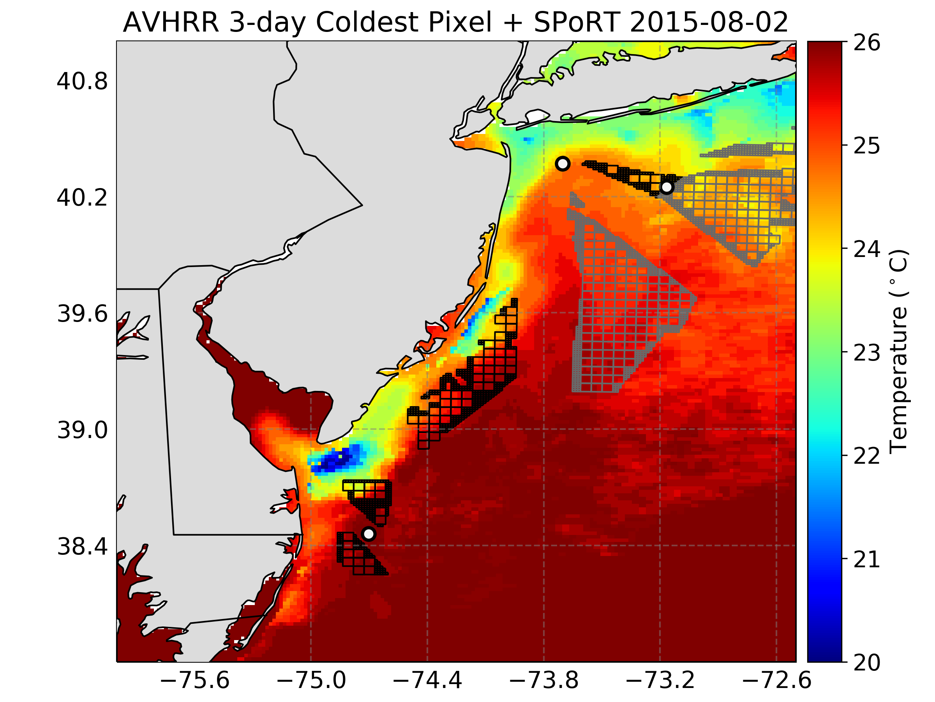
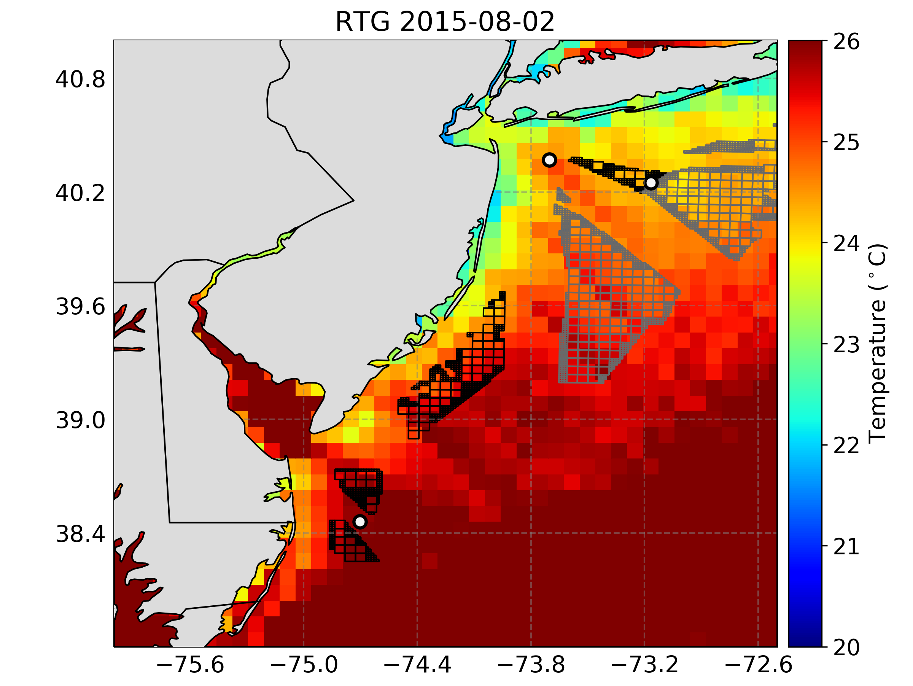
How Does Upwelling Influence Modeled Winds?
Localized Custom Sea Surface Temperature Product
Global Sea Surface Temperature Product

Slide 15
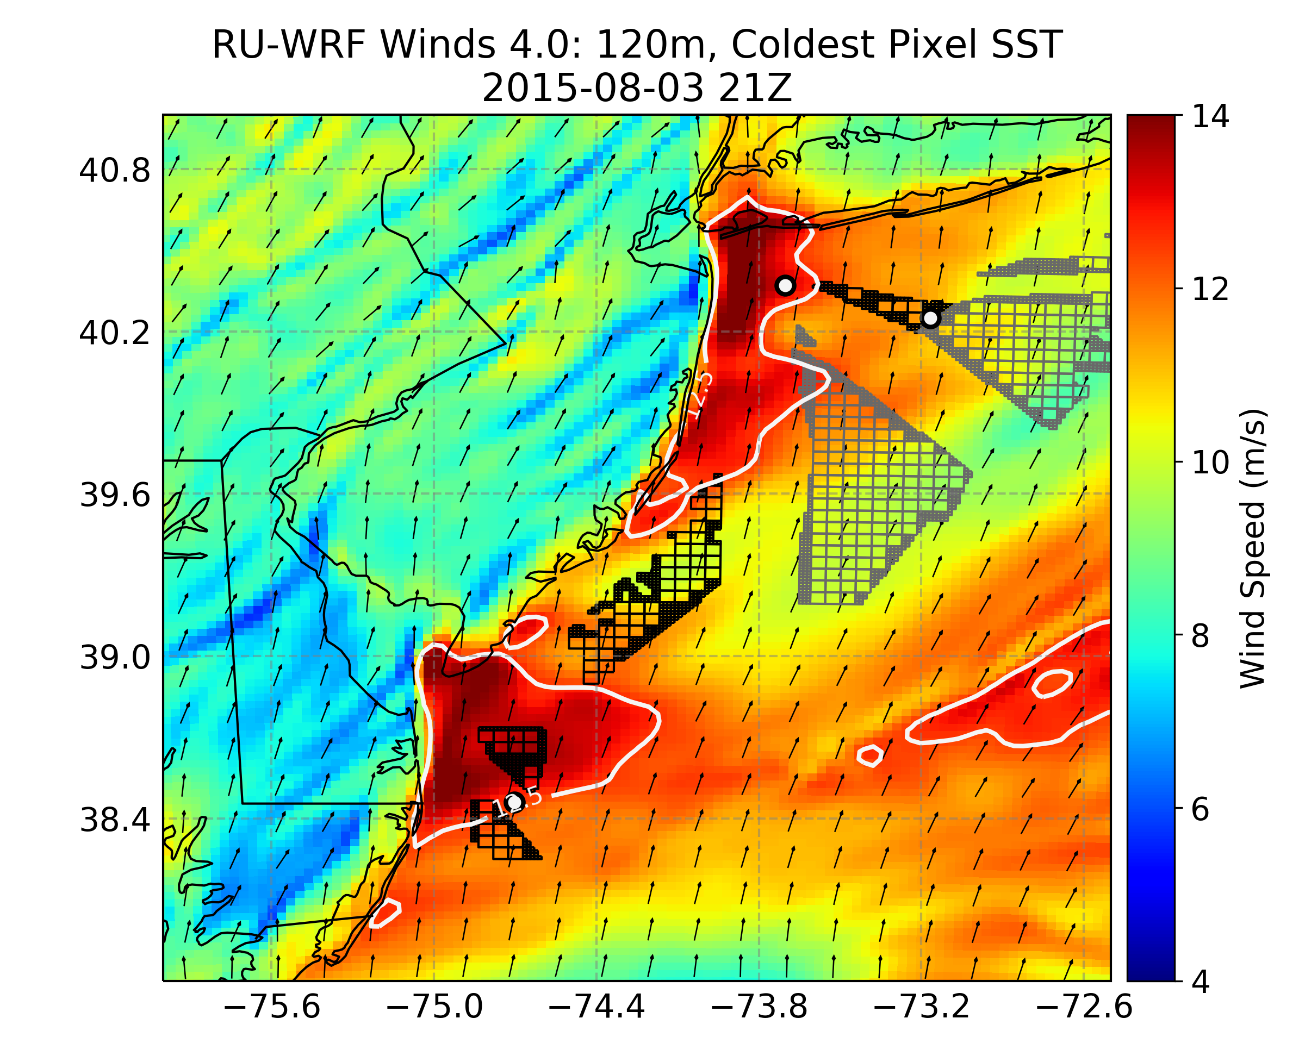
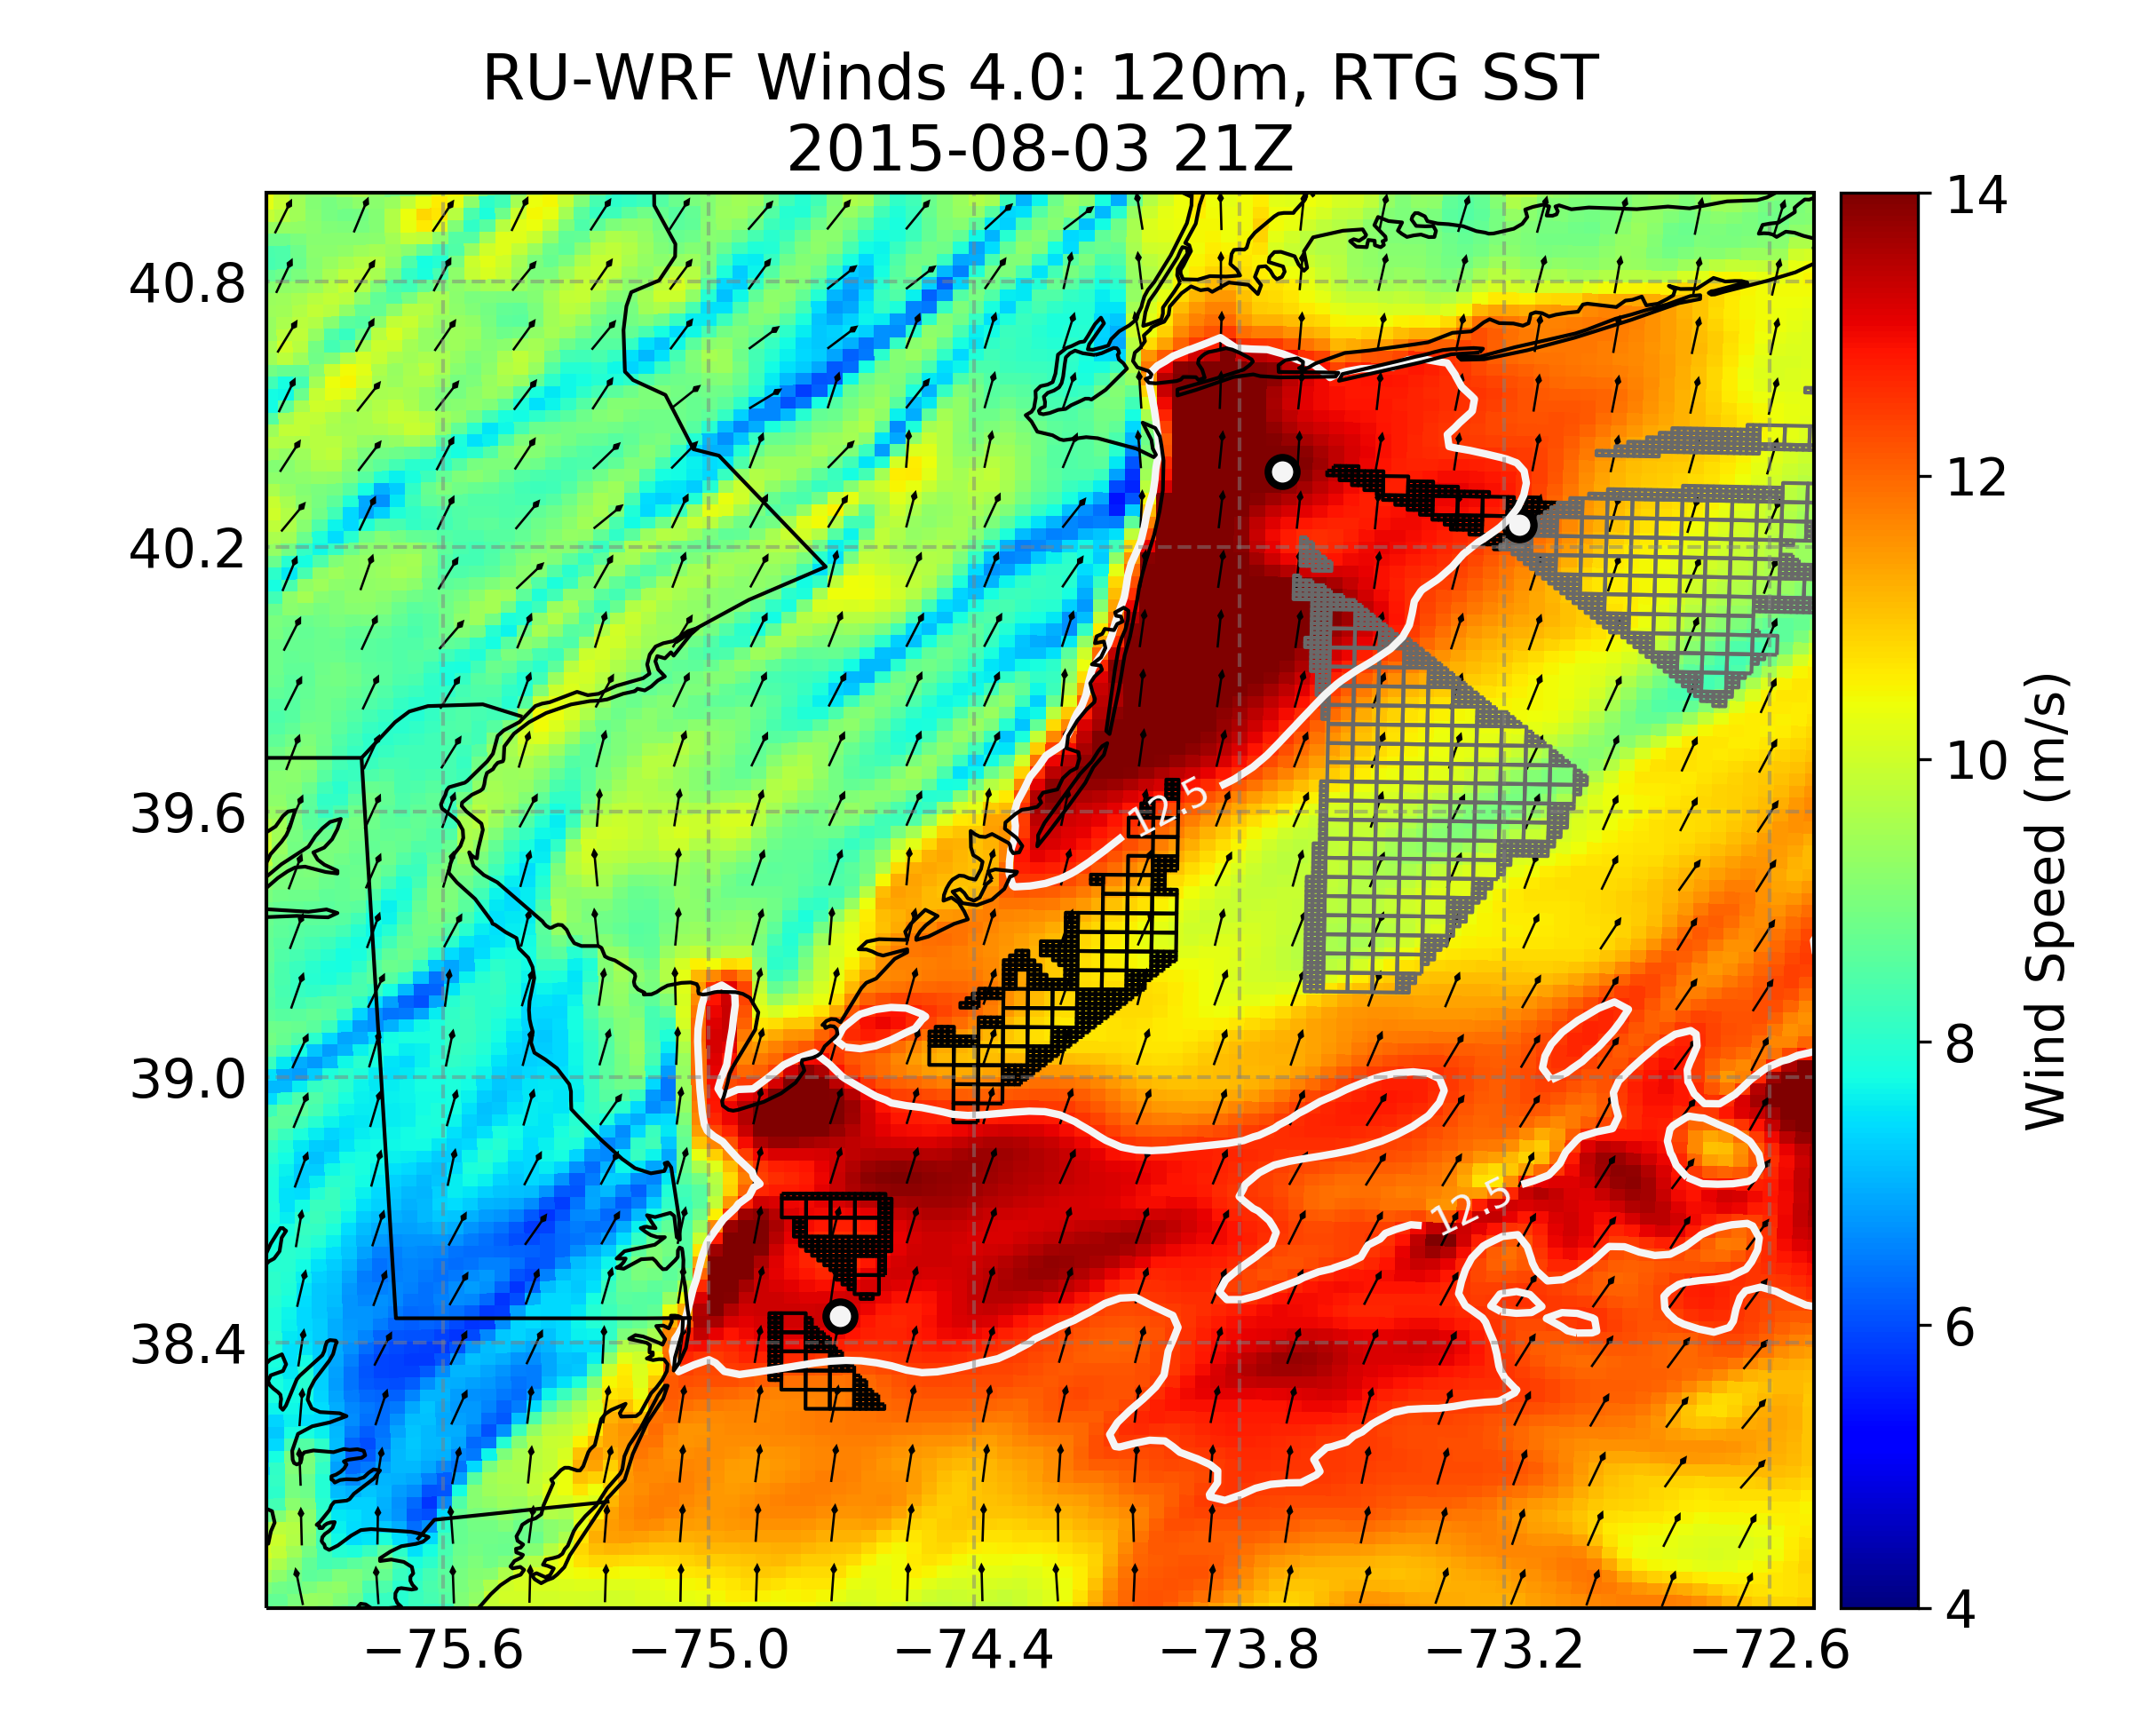
WRF Model Sensitivity to SST Input
Localized Custom Sea Surface Temperature Product
Global Sea Surface Temperature Product
Notes:
What to emphasize: Upwelling can have a significant influence on winds within the rotor layers. White contour lines is the 12.5 m/s wind speed.
Specific to this particular time period

Slide 16
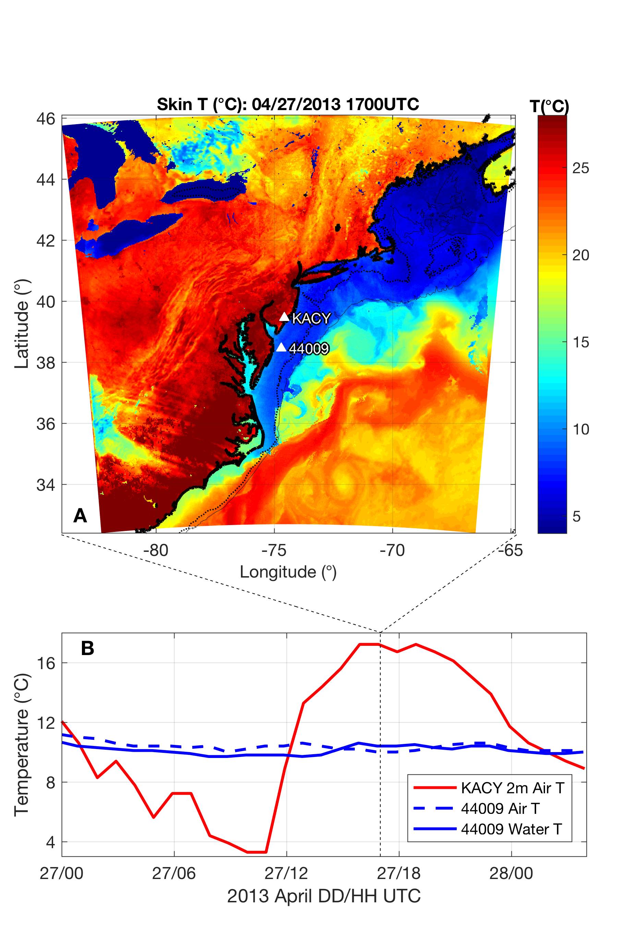
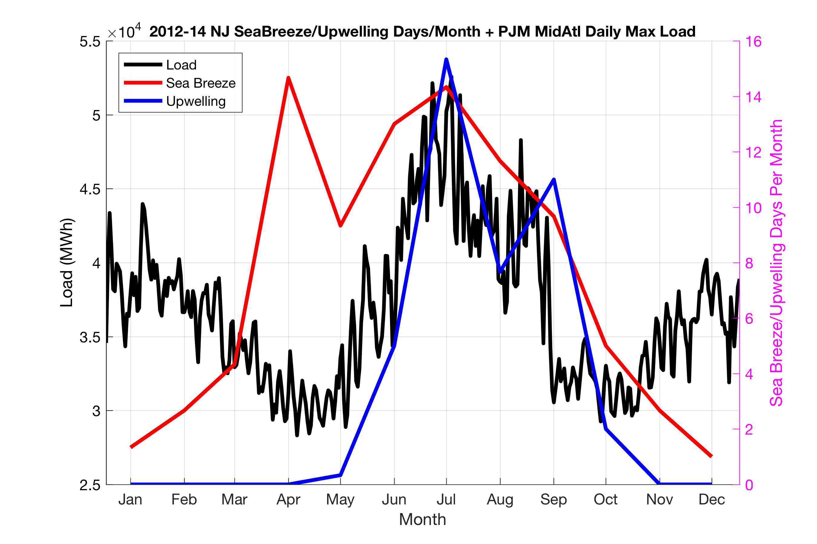
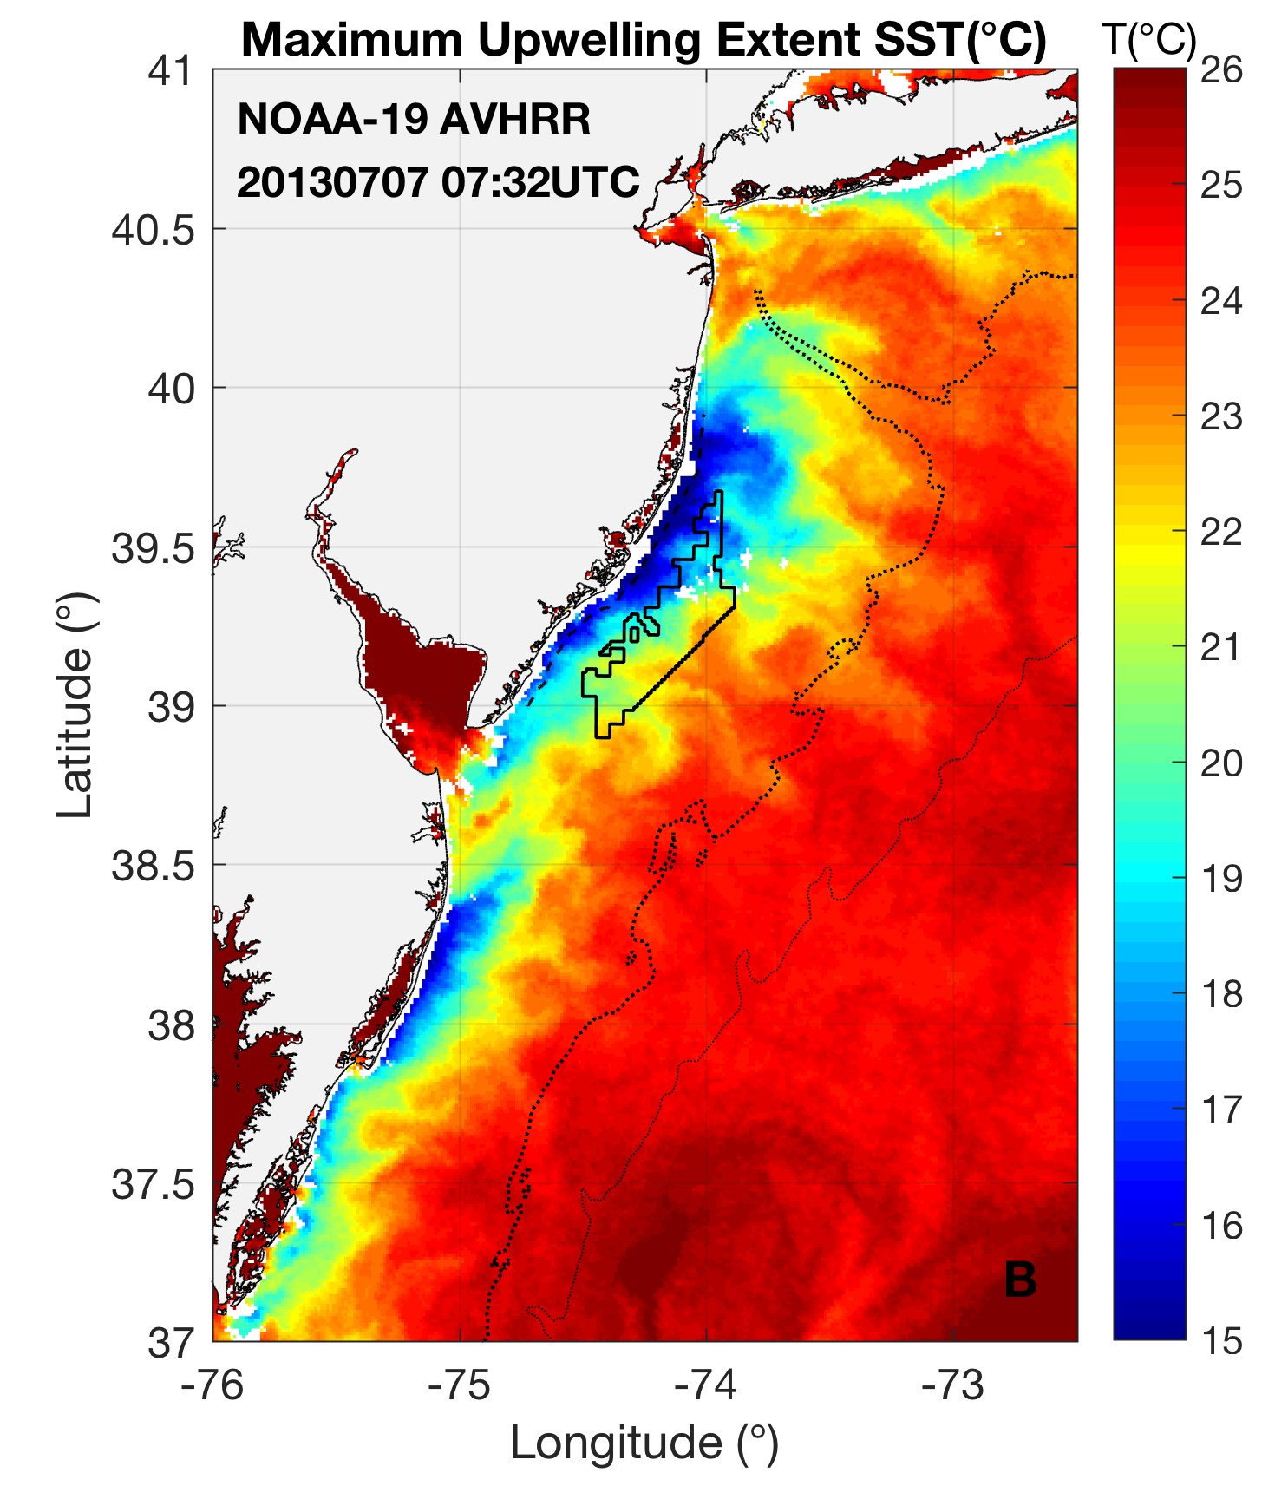
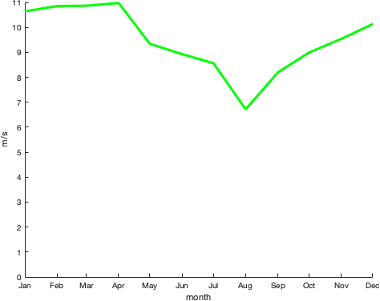
Sea Breezes & Upwelling, Coincident with Electricity Demand
Seroka et al., 2018 JGR:Atmospheres
Notes:
NJ sea breeze and coastal upwelling coincident with peak electricity demand
-Sea breeze time of day (afternoon/evening) is also coincident with peak demand time of day (5-7 pm)
Set up Case 1, upwelling sensitivity

Slide 17
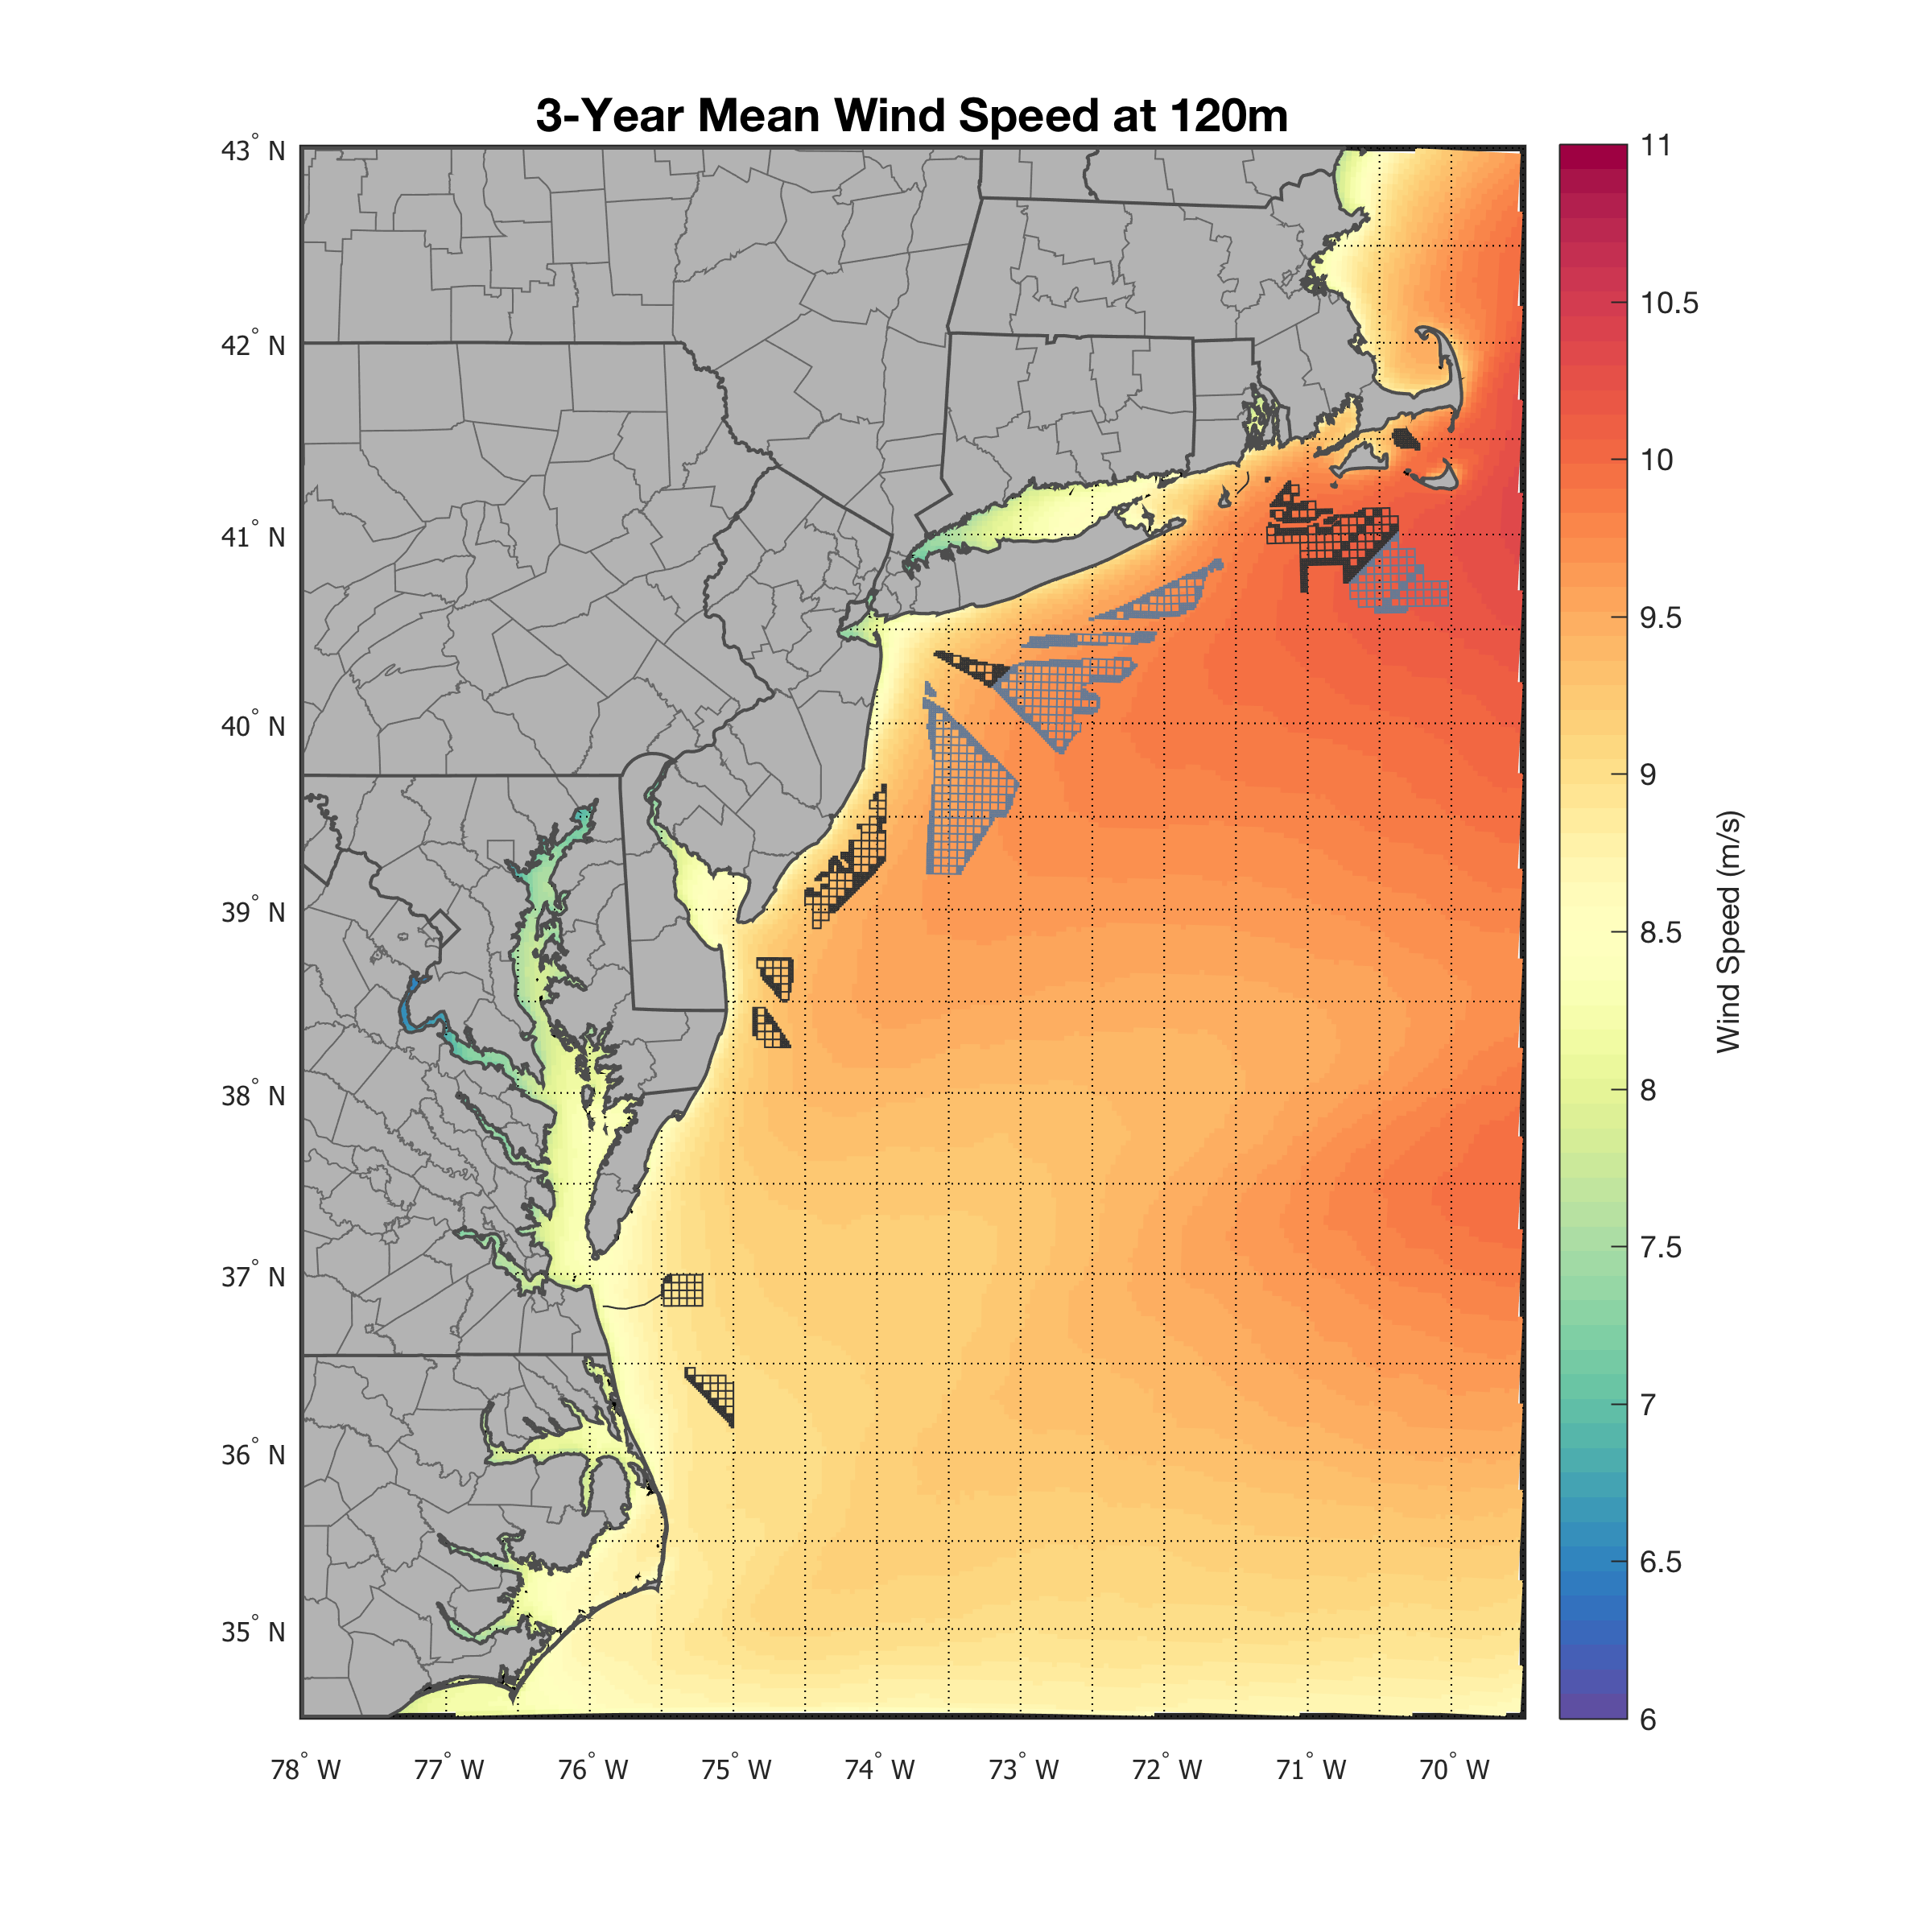
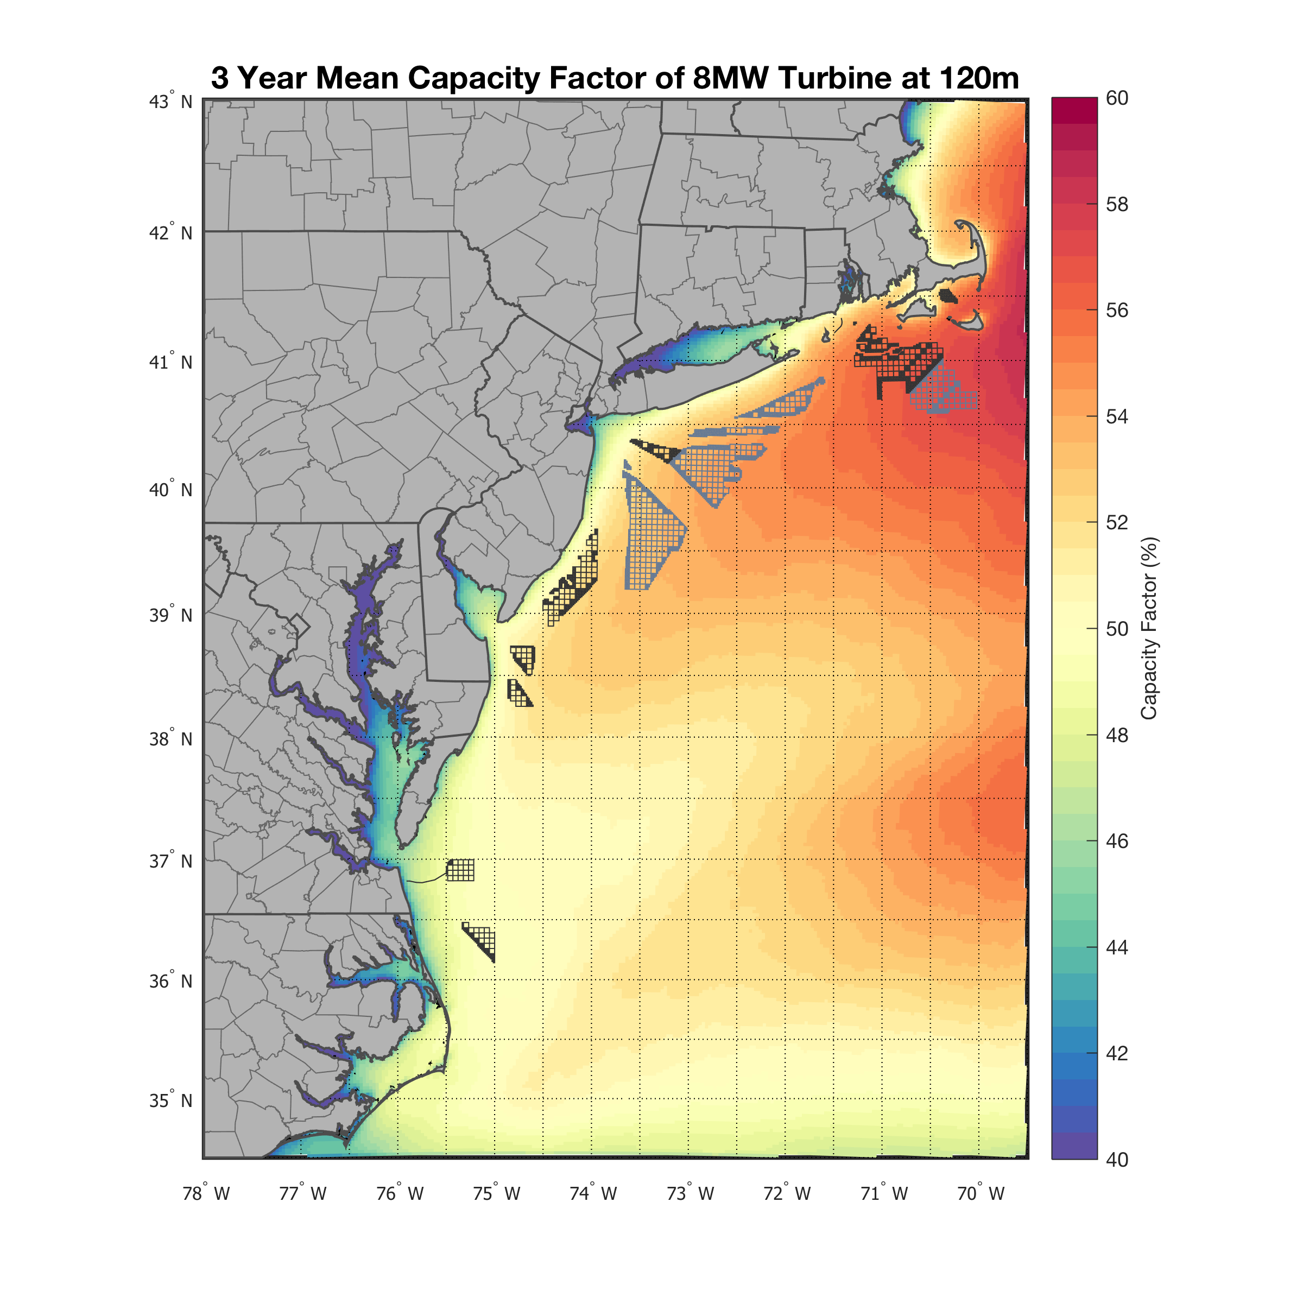
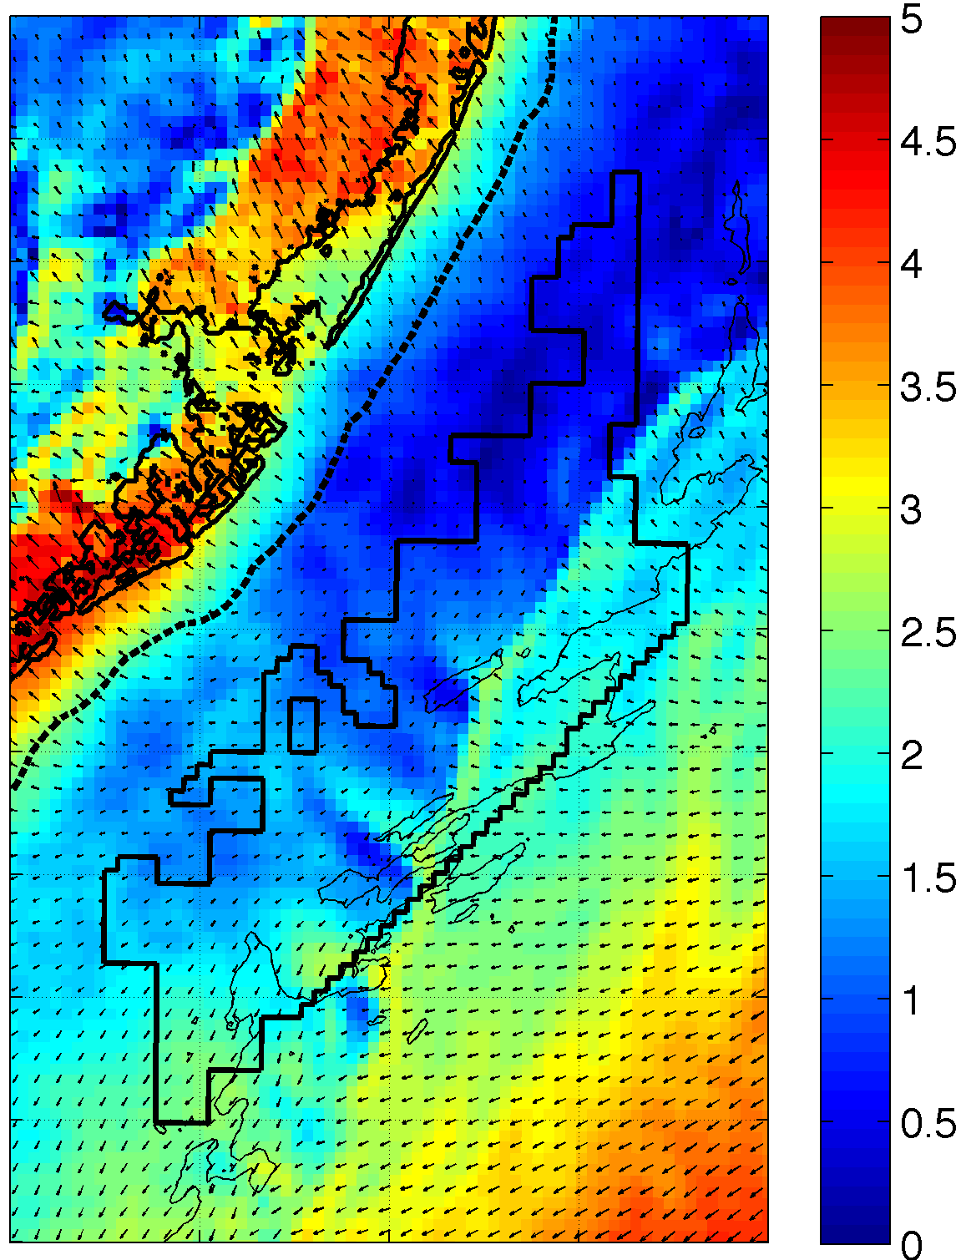
RU-WRF Wind Resource
3 Year Mean
One Hour Sample
8.5 to 10 m/s
48% to 55%
Modeling at 3km grid spacing, 10m height
Hourly winds
Notes:
See the speed gradient a bit more clearly

Slide 18
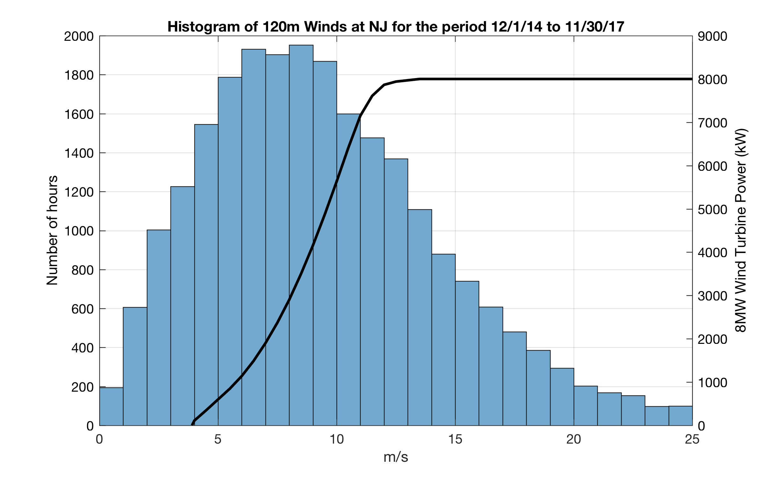
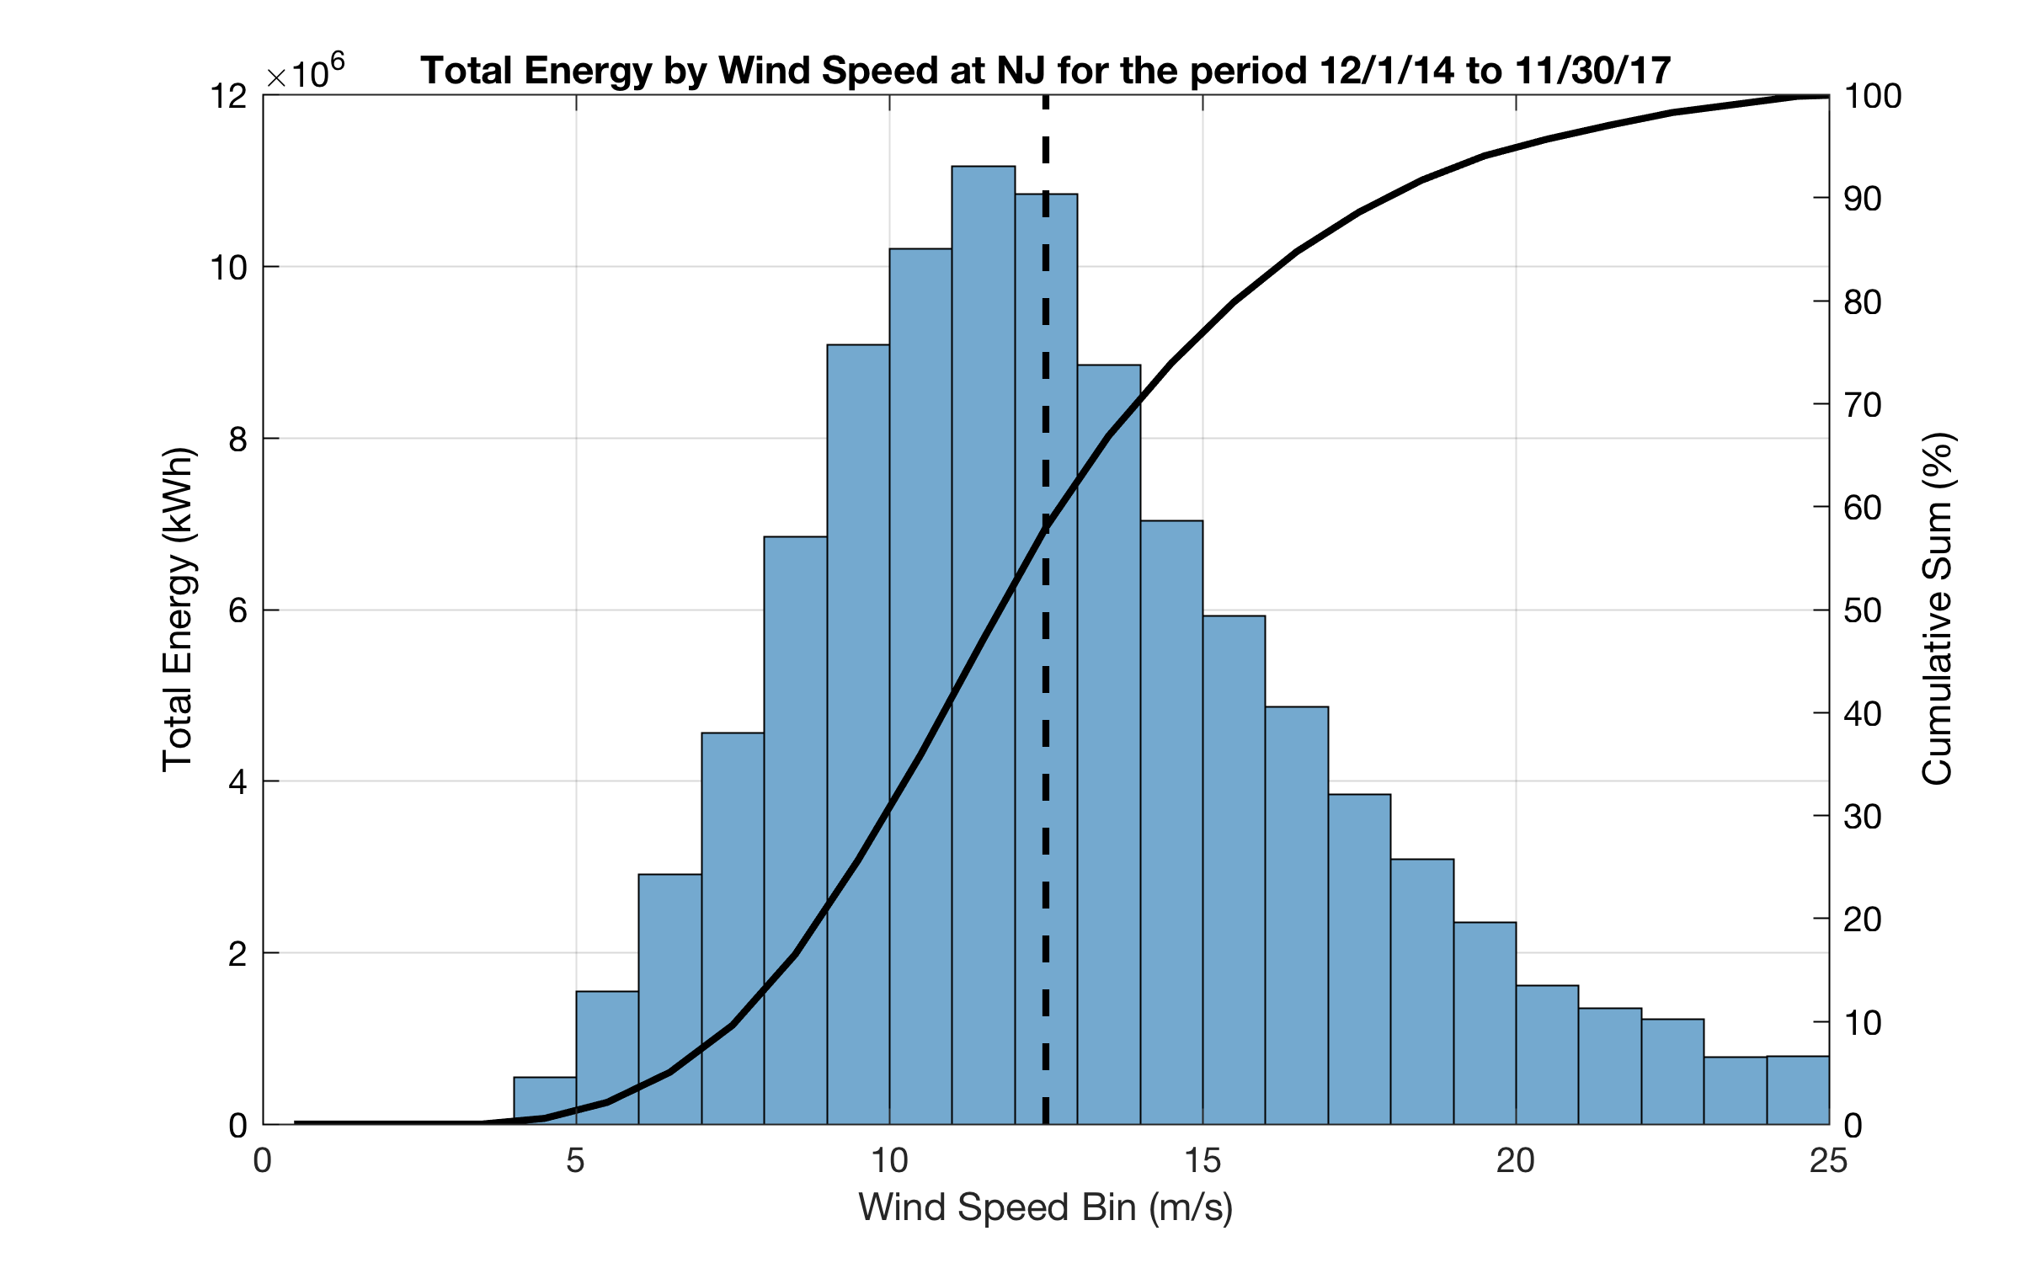
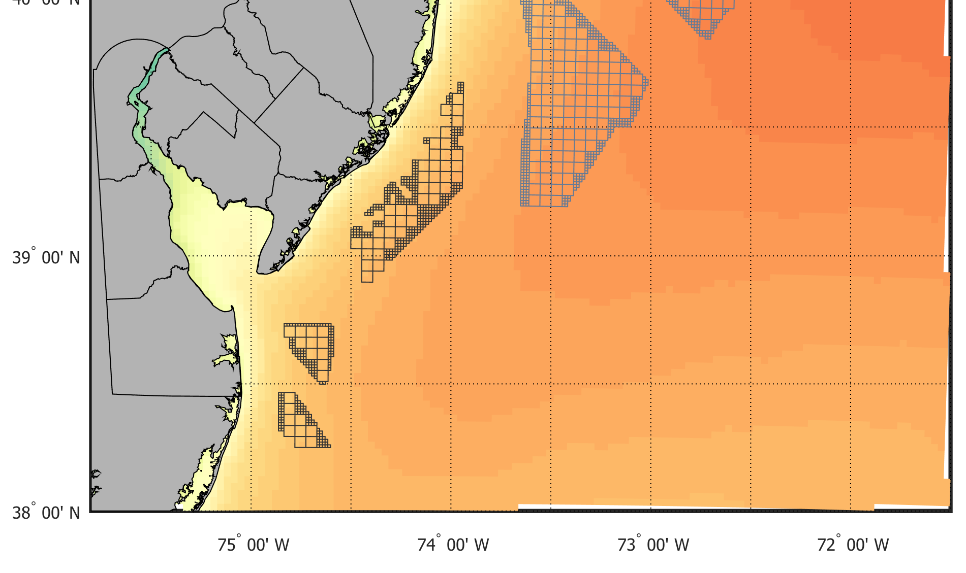
RU-WRF Wind Resource: 3 Years of Power
8 MW wind turbine
12.5 m/s rated speed
60% of energy extracted below turbine rated speed
Virtual Met Tower
Notes:
Wind: first plot shows histogram of winds for a recent quarter, along with the power curve for an 8 MW wind turbine
Point out rated speed of 12.5 m/s
Bottom shows cumulative distribution of energy based on those winds. 33% of the power occurs when the turbine is producing full power.
Highlights the importance of getting the winds right, since power is cube of wind, so a 1 m/s wind speed difference on the curve could be a 1500 MW difference in power (20%)

Slide 19
RU-WRF Captures Observed Wind Distribution
Q-Q Plot, 2012-2016
Accurate resource assessments rely on correctly capturing the wind distribution (quantile-quantile plot)
RU-WRF effectively captures the distribution of wind speeds off of NJ at NOAA buoys
At speeds above 12.5 m/s, our sample turbine is at full power
Expanded validation with more observations (particularly hub height) helps improve model!
12.5 m/s turbine rated speed
Notes:
Shows how well the model predicts each 1% of the wind distribution

Slide 20
Improving Models with Better Observations
DOE Wind Forecast Improvement Project
  WFIP1 – Great Plains, US (2011-2012)
  WFIP2 – Complex Flow, Pacific Northwest US (2016-2017)
  WFIP3 – Offshore?
Multiple collaborators, multiple observing platforms
Goal to improve NOAA models
WFIP2 improvements in latest versions of WRF, show initial promise in improving offshore winds in the model
DOE WFIP2

Slide 21
Regional Ensemble Approach
RUCOOL worked with NREL to evaluate RU-WRF model and validation
NREL performed year-long model ensemble with 24 ensemble members
Validated against NOAA buoys and DOE flidar
SST, model setup, model version all matter
Ensemble modeling, with customized regional setups, can improve quantifying of the offshore wind resource
Final report coming soon!

Slide 22
In Summary
Many, often complimentary, options for wind resource assessment
No one-size-fits-all solution
Plenty of work still to be done
  Improving models
  Operational forecasting
  Machine learning
Collaboration is key!
Big data is only going to continue to get bigger
Notes:
Big data is only going to be getting bigger – more observations, more model data

Slide 23
Thank you!
jbrodie@marine.rutgers.edu

